Slide 1

Vishwakarma Institute of Technology, Pune
Computer Vision, 2nd May 2024
Enhancing Visibility in Foggy Landmark Images: Advanced Restoration Methods
(CV CP ID- 04)
Student Details:
Shruti Korpade, Hemal Kulkarni, Rahul Kumbhar
Supervisor: Dr. Jyoti Madake
Department of E&TC Engineering
Notes:
1

Slide 2

CV CP ESE
INDEX
01 | INTRODUCTION
02 | LITERATURE REVIEW
03 | RESEARCH GAP
04 | NOVELTY
05 | METHODOLOGY
06 | RESULTS
07 | CONCLUSION

Slide 3
INTRODUCTION
01
Hazy or foggy conditions can obscure key features in historical images, hindering proper documentation and preservation.
02
Efficient picture restoration requires advanced algorithms
03
Use of Markov Random Fields and Riemannian rank-adaptive method for low-rank matrix completion.
04
Combined approach to enhance restoration process, focusing on mitigating haze and revealing intricate details.

Slide 4

LITERATURE REVIEW

Slide 5
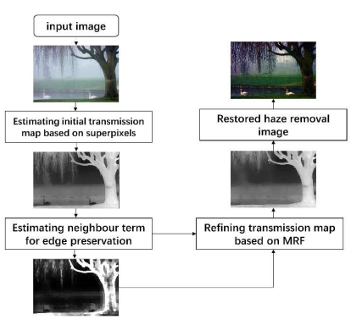
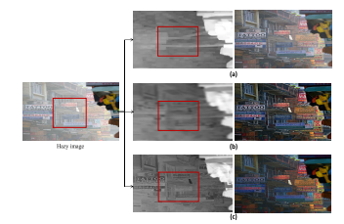
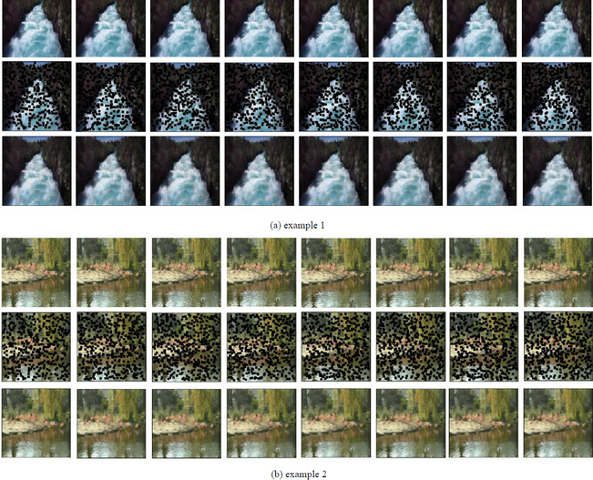
Image Haze Removal Based on Superpixels and Markov Random Field [1]
Utilizes superpixels and Markov random field.
Addresses block effect and light-like object handling.
Fast and Efficient Visibility Restoration Technique for Single Image Dehazing and Defogging [5]
A novel approach using Thresholding & Gamma Transformation
Highest processing time
Video inpainting by Markov Random Field Modeling and Gibbs Sampling [10]
To recover the distorted pixels.
Not able to clarify the given image properly

Slide 6
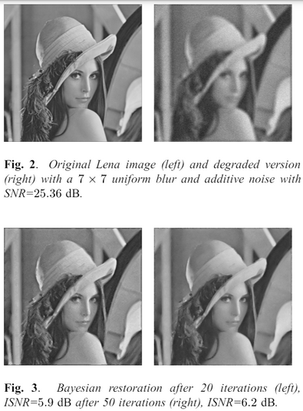
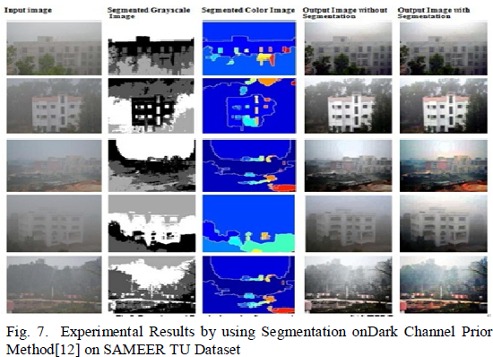
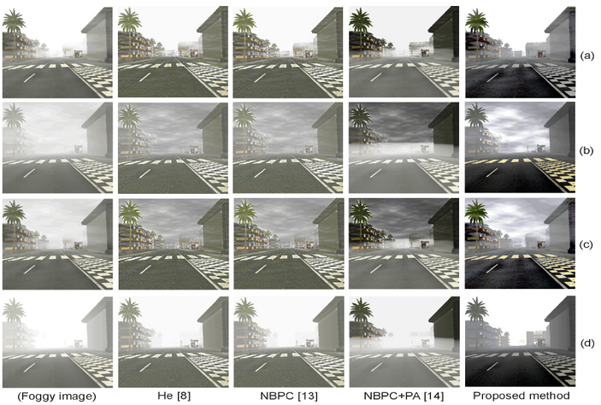
Quality Enhancement of Foggy Images comprising of Large Sky
Region on SAMEER TU Dataset [17]
Difficulties with large sky regions
Paper suggests segmentation strategy based on FCM clustering
Outperforms current techniques for real-time computer vision tasks
Inter-region linear smoothing function for foggy and hazy images [18]
Estimation of air-light photos and restoration of fog-free photos
Use of white balancing and inter-region linear smoothing
Not dependent on the quantity of fog and does not require human input
Markov Random Fields using Complex Line Process: an Application to Bayesian Image Restoration [12]
Accounts for both the intensity and the orientation of image edges.
Orientation of image edges are locally estimated by a computationally efficient filtering stage.

Slide 7

RESEARCH GAP
Failure in enhancing fog-degraded images, particularly those containing sky regions.
Fog color in foreground is realistic, but sky regions are gray and homogeneous.
High brightness values in the sky region lead to color degradation.
Sky regions being severely affected, causing high brightness and color distortion.

Slide 8

NOVELTY
Approach: Integration of two haze removal algorithms - Markov Random Fields + Riemannian Rank Adaptive Method
Lowest Entropy
Improved (Higher) MSE
Highest Visibility Metric

Slide 9
METHODOLOGY

Slide 10
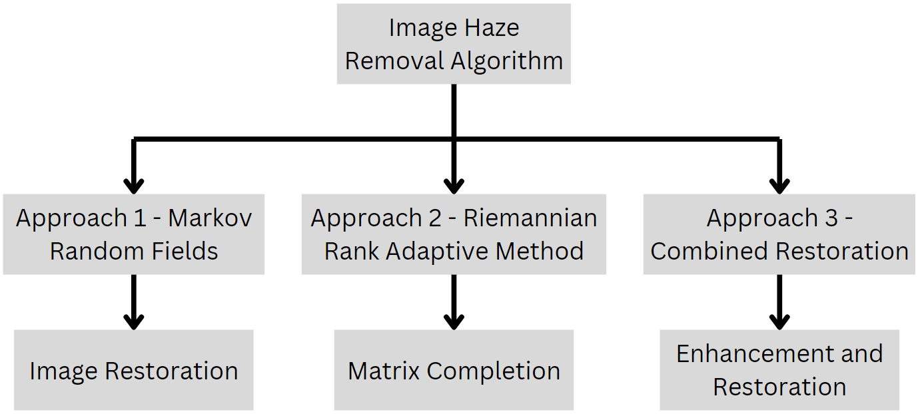
BLOCK DIAGRAM OF SYSTEM

Slide 11
Markov Random Fields
Models the relationship between pixels based on spatial proximity and similarity.
Estimates the transmission map of an image affected by haze.
The estimated transmission map is used to remove haze from the image by adjusting pixel intensities to enhance clarity.
Riemannian Rank-Adaptive Method
Technique used for low-rank matrix completion tasks in image processing.
Designed to provide accurate completion results, even in scenarios where data is degraded or missing.
Uses haze removal techniques such as dark channel prior, guided filtering, or other methods to adjust pixel values based on the estimated haze levels and enhance clarity.

Slide 12
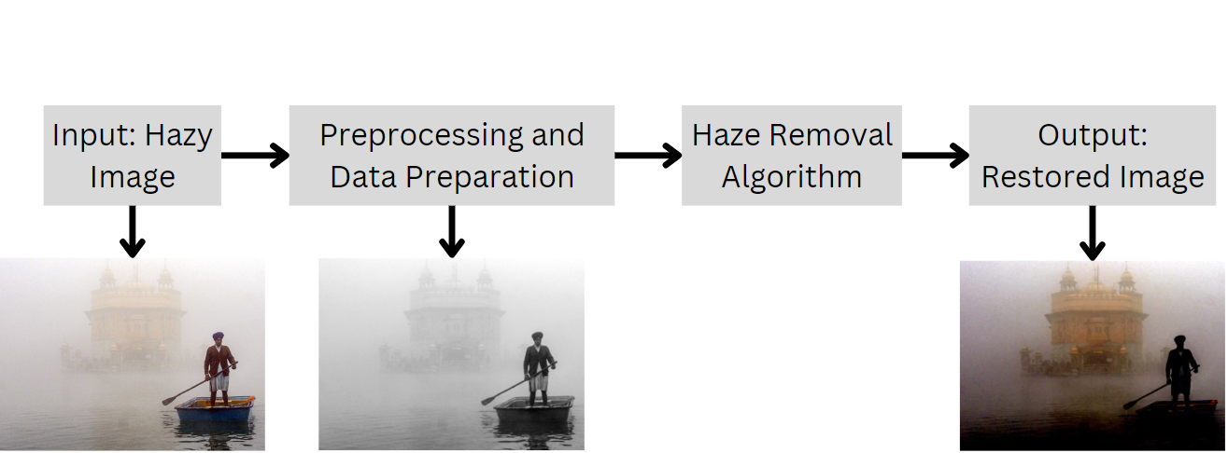
SYSTEM ARCHITECTURE

Slide 13
PARAMETERS
RIEMANNIAN RANK ADAPTIVE METHOD
MARKOV RANDOM FIELDS
COMBINED APPROACH
omega = 0.98
beta = 0.9
patch_size = 5
mrf_iteration = 4
atmosphere = np.array([230, 230, 230])
Window Size = 15
Omega = 0.95
Atmosphere Estimation = 55
Minimum Transmission Threshold = 0.1
window_size = 15
omega = 0.98
guided_radius = 40
Minimum Transmission Threshold = 0.4

Slide 14
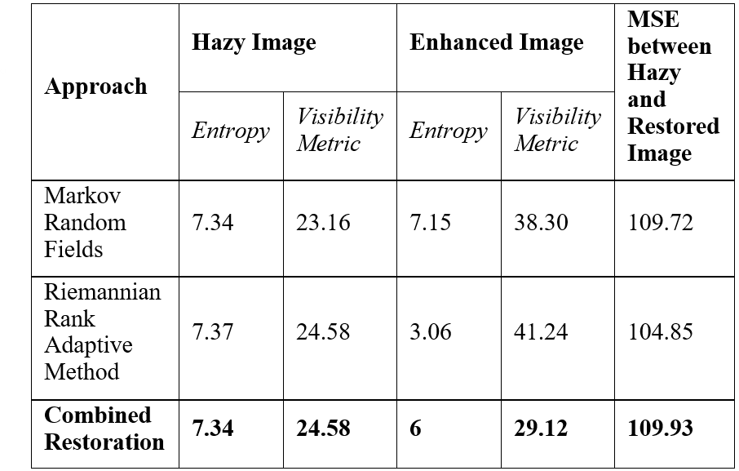
RESULTS
Performance Evaluation

Slide 15
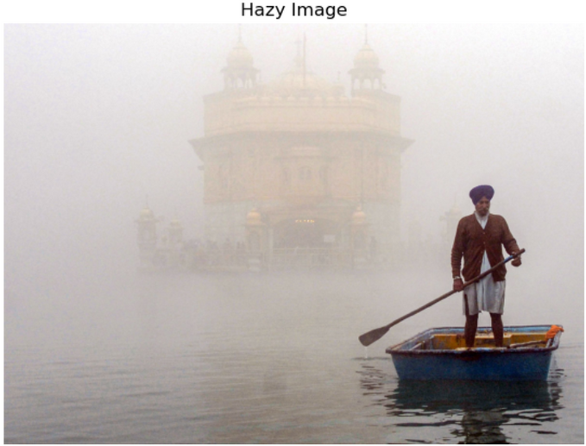
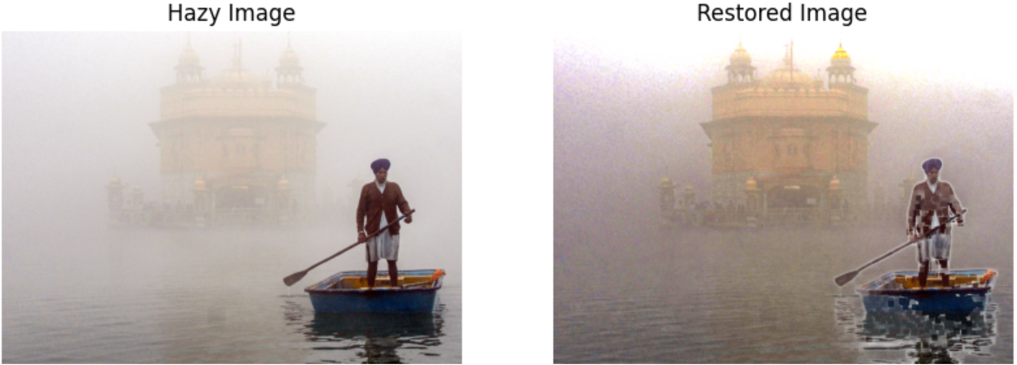
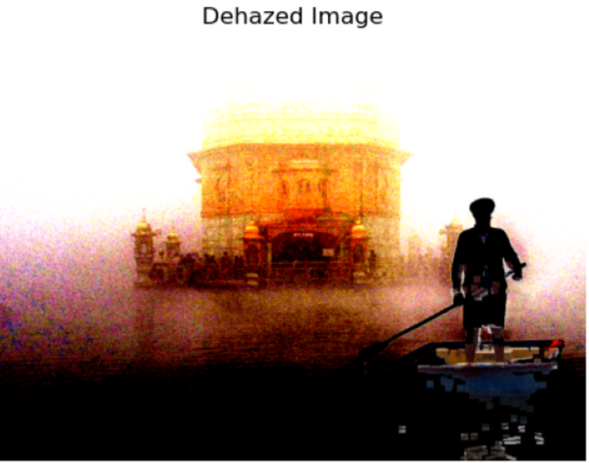
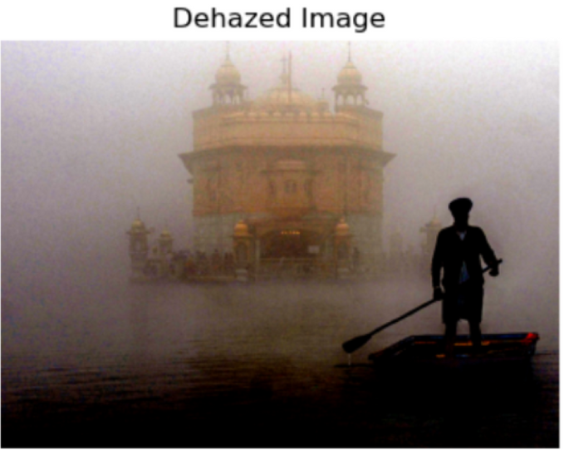
RESULTS (Image Outputts)
Markov Random Fields
Hazy Image
Riemannian Rank Adaptive Method
Combined Method

Slide 16
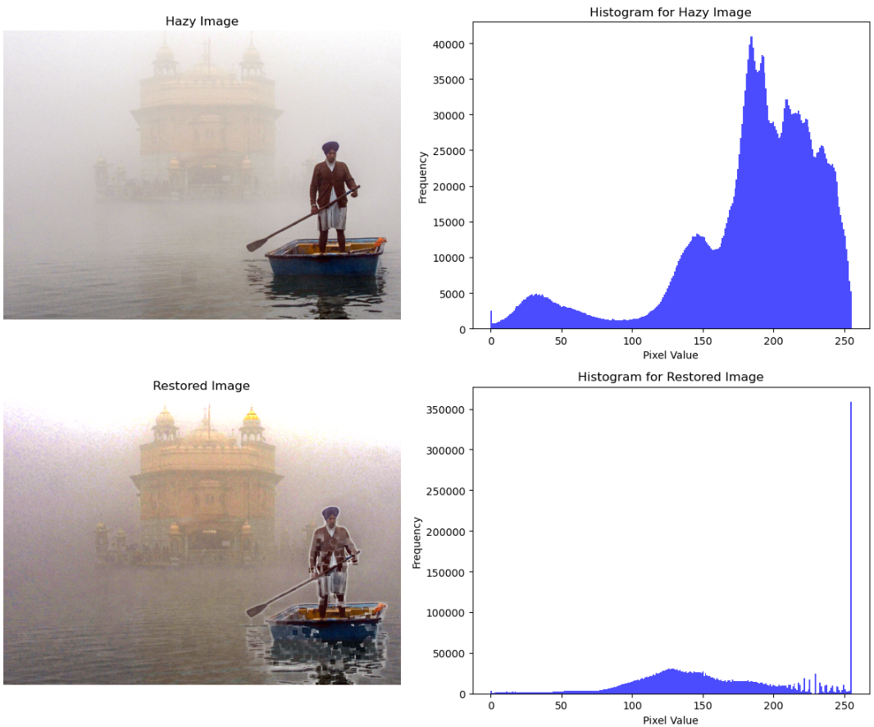
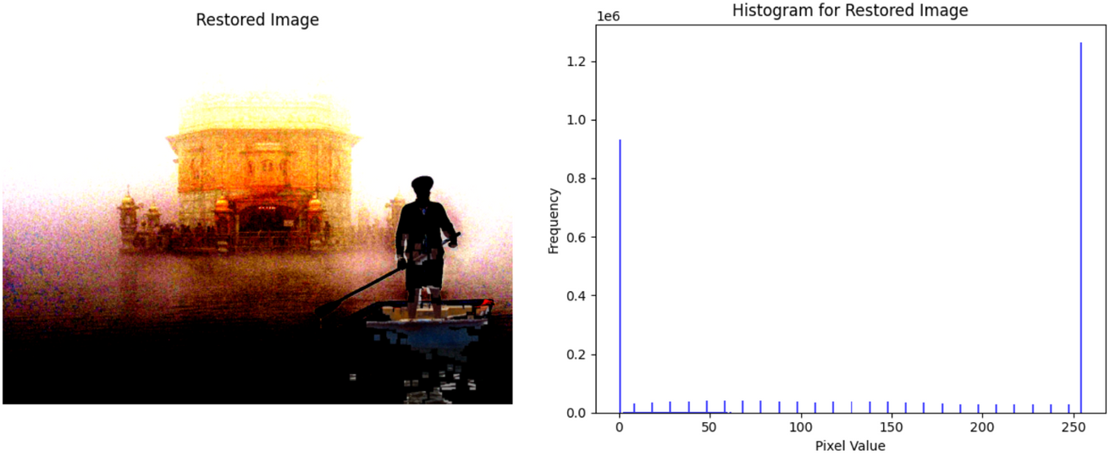
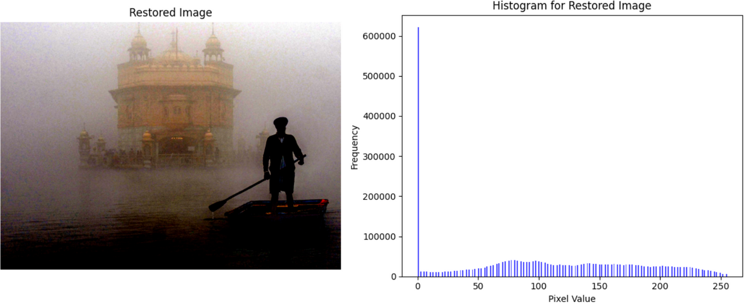
RESULTS (Histograms)
Markov Random Fields
Hazy Image
Riemannian Rank Adaptive Method
Combined Method

Slide 17
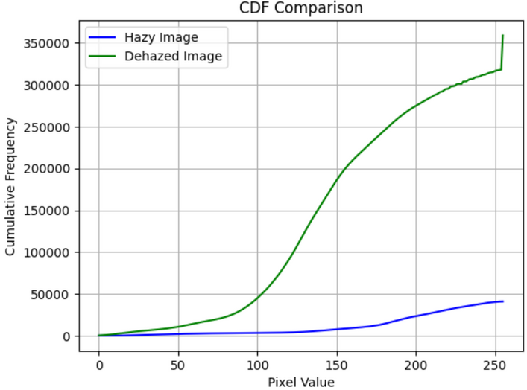
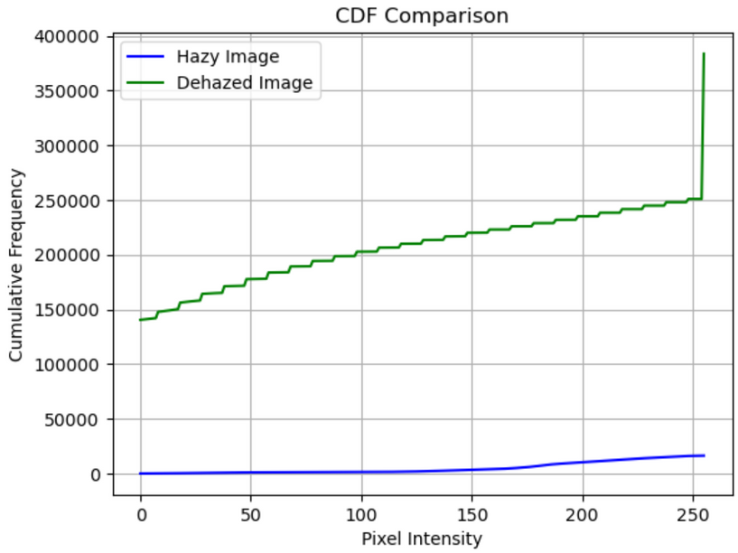
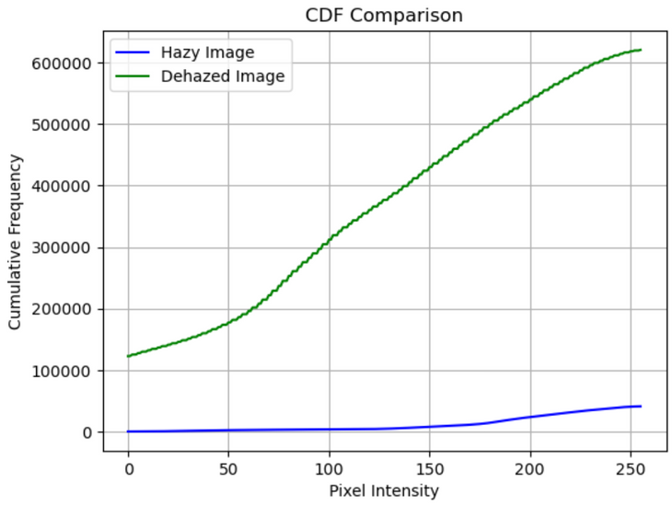
RESULTS (CDF Distribution Graphs)
Riemannian Rank Adaptive Method (Approach 2)
Markov Random Fields (Approach 1)
Combined Method (Approach 3)

Slide 18
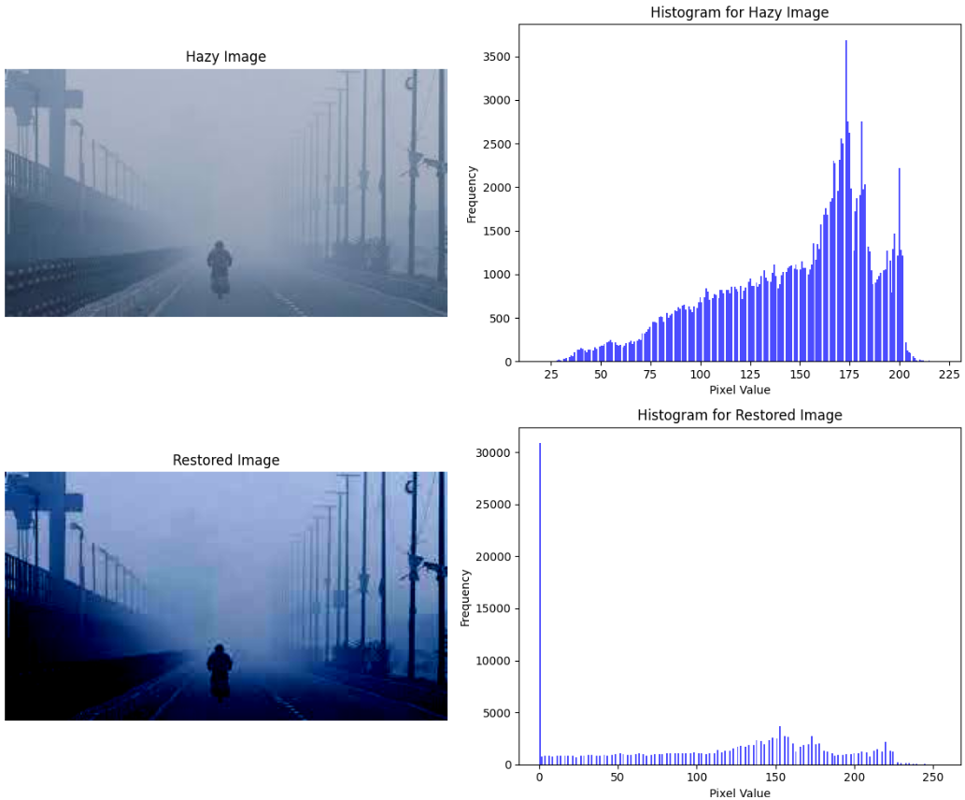
RESULTS (Unfavourable Case)

Slide 19
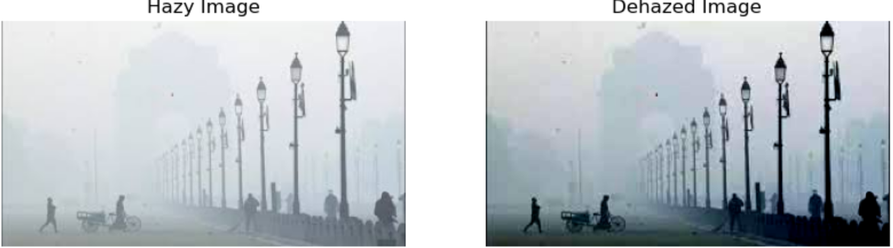
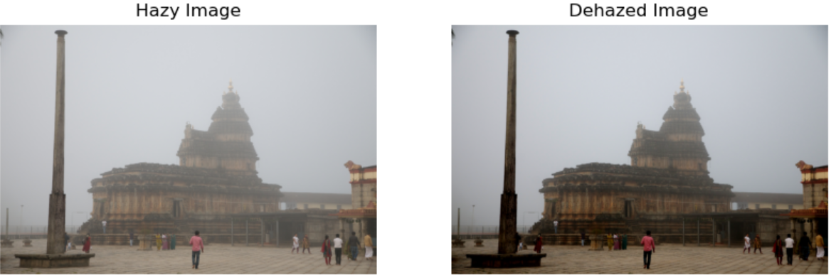
RESULTS (Other Monuments and Image inputs)

Slide 20
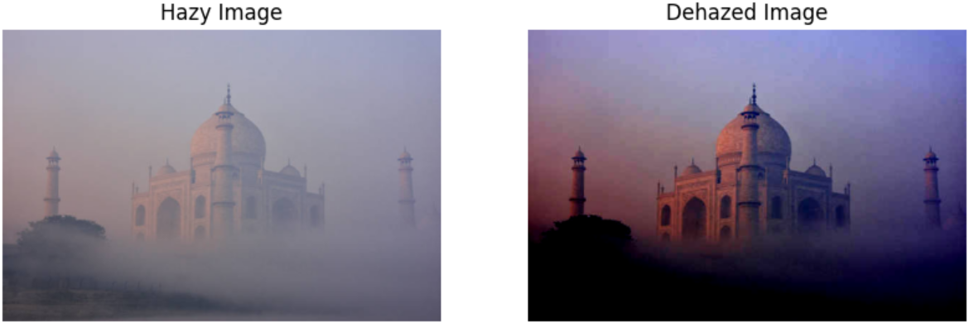
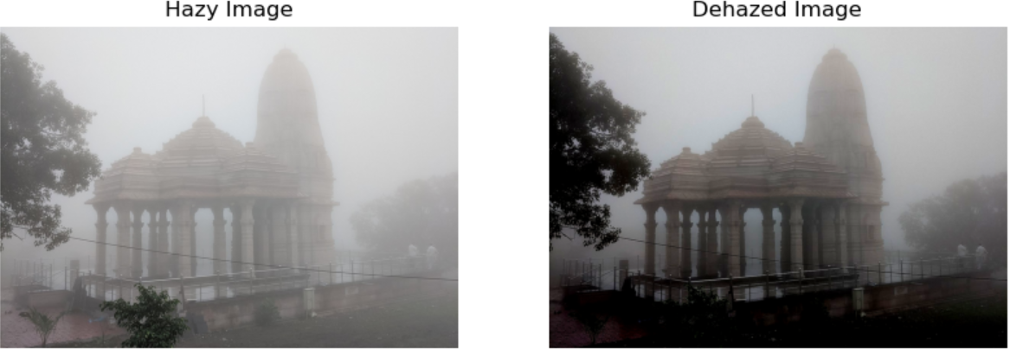
RESULTS (Other Monuments and Image inputs)

Slide 21
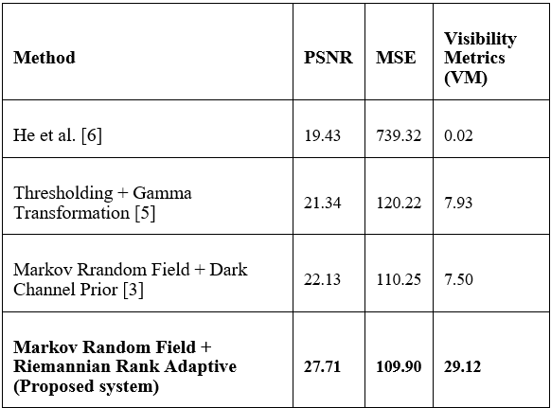
COMPARISION OF EXISTING SYSTEM

Slide 22


CONCLUSION
Combination of Markov Random Fields and Riemannian Rank Adaptive methods for superior performance in removing atmospheric haze and enhancing clarity.
Concluded that the proposed system outperforms individual techniques through quantitative analysis and qualitative visual assessments
Mitigates haze, reveals obscured details, and restores vibrant colors and depth perception.
Lowest Entropy of 6.0 for the enhanced image
Highest Visibility Metric of 29.12 and improved MSE of 109.93 compared to the hazy image.

Slide 23
REFERENCES
[1] Y. Tan and G. Wang, "Image Haze Removal Based on Superpixels and Markov Random Field," in IEEE Access, vol. 8, pp. 60728-60736, 2020, doi: 10.1109/ACCESS.2020.2982910.
[2] L. Caraffa and J. -P. Tarel, "Markov Random Field model for single image defogging," 2013 IEEE Intelligent Vehicles Symposium (IV), Gold Coast, QLD, Australia, 2013, pp. 994-999, doi: 10.1109/IVS.2013.6629596.
[3] Xu, H., Tan, Y., Wang, W. et al. Image Dehazing by Incorporating Markov Random Field with Dark Channel Prior. J. Ocean Univ. China 19, 551–560 (2020). https://doi.org/10.1007/s11802-020-4003-6
[4] Chen, Bo-Hao, and Shih-Chia Huang. "An advanced visibility restoration algorithm for single hazy images." ACM Transactions on Multimedia Computing, Communications, and Applications (TOMM) 11, no. 4 (2015): 1-21.
[5] S. K. Sahoo, A. Kumari and M. C. Chinnaiah, "Fast and Efficient Visibility Restoration Technique for Single Image Dehazing and Defogging," in IEEE Access, vol. 9, pp. 48131-48146, 2021, doi: 10.1109/ACCESS.2021.3068446.

Slide 24
REFERENCES
[6] Bansal, Bindu, Jagroop Singh Sidhu, and Kiran Jyoti. "A review of image restoration based image defogging algorithms." International Journal of Image, Graphics and Signal Processing 9, no. 11 (2017): 62.
[7] B. Vandereycken and A. Uschmajew, "Greedy rank updates combined with Riemannian descent methods for low-rank optimization," 2015 International Conference on Sampling Theory and Applications (SampTA), Washington, DC, USA, 2015, pp. 420-424, doi: 10.1109/SAMPTA.2015.7148925.
[8] R. Yamaki and A. Hirose, "Singular Unit Restoration in Interferograms Based on Complex-Valued Markov Random Field Model for Phase Unwrapping," in IEEE Geoscience and Remote Sensing Letters, vol. 6, no. 1, pp. 18-22, Jan. 2009, doi: 10.1109/LGRS.2008.2005588.
[9] S. Derin Babacan, R. Molina and A. K. Katsaggelos, "Generalized Gaussian Markov random field image restoration using variational distribution approximation," 2008 IEEE International Conference on Acoustics, Speech and Signal Processing, Las Vegas, NV, USA, 2008, pp. 1265-1268, doi: 10.1109/ICASSP.2008.4517847.
[10] X. Mei, "Video inpainting by Markov Random Field modeling and Gibbs sampling," 2017 IEEE 2nd Advanced Information Technology, Electronic and Automation Control Conference (IAEAC), Chongqing, China, 2017, pp. 2275-2278, doi: 10.1109/IAEAC.2017.8054425.

Slide 25
THANK YOU
We would like to extend our sincere gratitude and thank you for giving us the opportunity to present our work.

